Slide 1
SOMPHONY: Visualizing Symphonies using 3D Self-Organizing Maps
Cruz, Edwardo
Dionisio, Jefferson
Fukuoka, Kenji
Portales, Naomi
Advised by: Fritz Kevin Flores

Slide 2
PRESENTATION OUTLINE
Research Description
Introduction
Research Gap
Research Objectives with respective scopes and limitations
Research Significance
Research Methodology
Research Activities
Calendar of Activities

Slide 3

Introduction
Musical Eras
Baroque Period (1600 to 1750)
Classical Period ( 1750 to 1820)
19th Century (1814-1914)
Romantic Period (1830-1910)
20th Century (1900-2000)
A History of Western Music (Grout, D., Palisca, C. 1996)
Nineteenth-Century Music (Dahlhaus, C. 1989)

Slide 4

Review of Related Literature
A Survey on Symbolic Data-Based Music Genre Classification
Corrêa, D. C., & Rodrigues, F. A., 2016
Ever-expanding music database
hard to classify music genre
Symbolic-based music feature used for training system for genre classification (MIDI, KERN)

Slide 5
Review of Related Literature
Automated Motivic Analysis via Melodic Clustering
Cambouropoulos, E. and Widmer, G. (2000)
Finding similarity in music patterns
Use differences in pitch-intervals and rhythm as basis for splitting one musical motive (small bits of music) from another

Slide 6
Review of Related Literature
Validating the Stable Clustering of Songs in a Structured 3D SOM
Azcarraga, A., Caronongan, A., Setiono, R., & Manalili, S. (2016)
Construct 2D SOM as 3D SOM using similar learning algorithm (cube)
Pre-processing (learning and labelling algorithm) and construct into a cube

Slide 7
Review of Related Literature
SOMphony: Visualizing Symphonies Using Self-Organizing Maps
Azcarraga & Flores (2016)
Influence of composers to others
Compare using 2D SOMs to find similarity among symphonies

Slide 8
SOMphony: Visualizing Symphonies Using Self-Organizing Maps
Makes use of jAudio for audio feature extraction and feature is used to feed data into machine learning algorithms.
Self-Oragnizing Maps (SOMs) are used to encode the musical trajectory of the different symphonies for visual analysis
K-means Clustering is used to partition similar nodes from the SOM Map
Notes:
Nodes in close proximity get grouped into a cluster
Clusters represent similarly sounding segments of music
Each music segment will have a Best Matching Unit that assigns where it belongs in a cluster

Slide 9
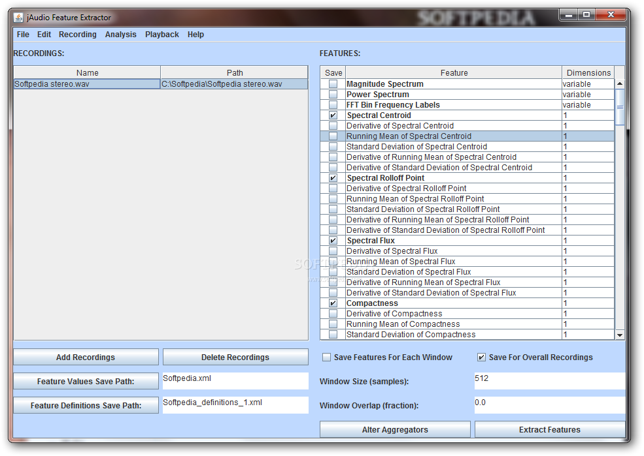

Slide 10
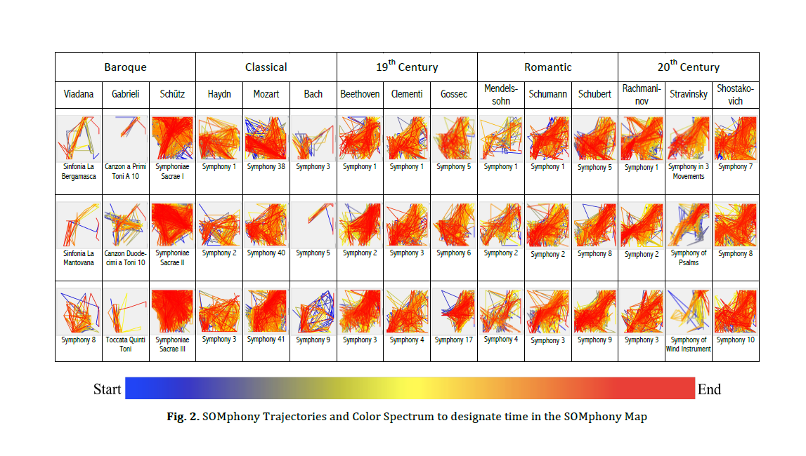
http://tinyurl.com/SOMphony

Slide 11
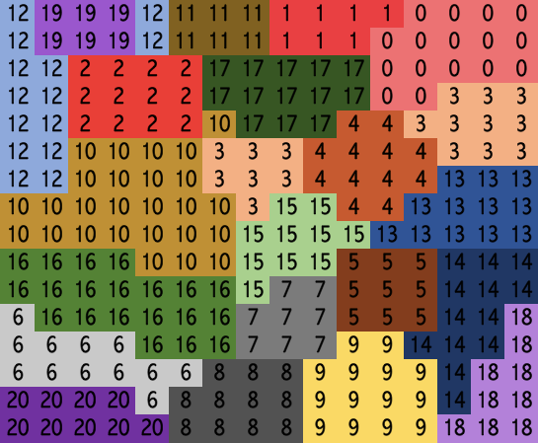
SOMphony map using k=21

Slide 12
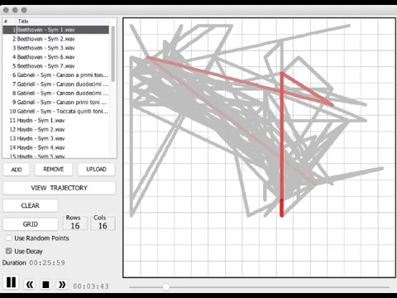

Slide 13
Research Gap
Using normalized frequency count as a basis for clustering does not consider the notion of time.
The sequence of music with regard to time is not considered.

Slide 14
General Objective
To develop a 3D visualization model that incorporates time series in comparing symphonies using 3D SOM’s

Slide 15
Specific Objective # 1
Objective #1
To include more symphonies to the data set
Scope and Limitations
Expand the previous data set to have 5 symphonies per composer
Composers still the same as previous data set
Quality of music data is disregarded if limited

Slide 16
Specific Objective # 2
Objective #2
To determine optimal features to be used
Scope and Limitations
Music features that can be extracted from JAudio
Limit features to top 20 features based on decision tree (top-down)

Slide 17
Specific Objective # 3
Objective #3
To add the in the time series variable
Scope and Limitations
0.5 second overlap
Each SOM will be assigned to a 1 sec segment

Slide 18
Specific Objective # 4
Objective #4
To create a 3D visualization model for the data
Scope and Limitations
OpenGL for visualization
Representing each map in a time series
Notes:
Generate SOM for all symphonies in data set
2D vs 3D SOM
Calculate Euclidean distance between clusters in the SOM, quantify similarities in percentages
Compare results with 3D SOM

Slide 19
Specific Objective # 5
Objective #5
To have participants listen and annotate the musical pieces for qualitative data
Scope and Limitations
◦ 50 Participants, with musical inclination over a period of 2 months.
◦ 5 symphonies deemed by the algorithm to have the highest % of similarity

Slide 20
Specific Objective # 6
Objective #6
To verify the results of the 3D SOMphony through the results obtained from the human participants
Scope and Limitations
◦ Results from the participants will be compared to the results of 3D SOMphony
◦ Only music samples used in the qualitative data

Slide 21
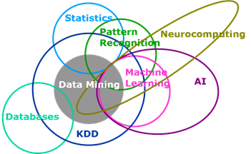
Research Significance
Machine Learning
Explore possible application of research to existing fields in machine learning
© Aatash Shah

Slide 22
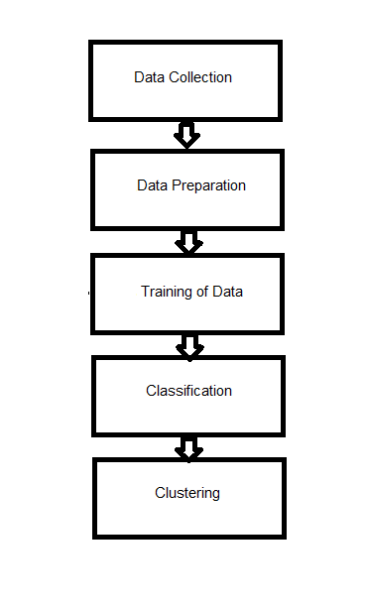
Research Significance
Methodology and Experiments
Serve as basis and reference for future research related to music feature visualization and analysis

Slide 23

Research Significance
Related Systems
Results of this study can be further used to improve systems such as Automatic Playlist Generation or studies on Music Theory
© Rachel Wells
Automatic Playlist Generation (Xingting Gong & Xu Chen, Stanford University)

Slide 24

Research Significance
Fields Outside Computer Science
The findings in this research may be used in almost any field that is time sensitive such as network traffic.
© Jose Lepez

Slide 25
Research Methodology
Research Activities
Concept Formulation and Review of Related Literature
Data Gathering
Pre-processing
Training
Visualization Development
Performance Evaluation and Human Evaluation
Data Analysis
Documentation

Slide 26
Data Gathering
Additional 2 symphonies per composer
Obtained through online or physical means (Youtube, CD’s)
File type and bitrate are not taken into consideration
Audio quality is disregarded

Slide 27
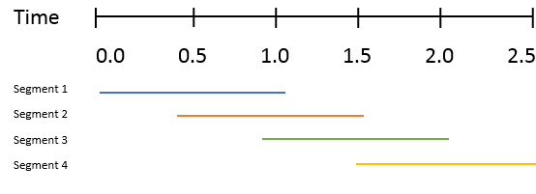
Pre-Processing
Audio files would be converted into wav files in preparation for splitting
Split audio files into 1 second segments overlapping at 0.5 second using WaveSplitter
Notes:
Mention what happens if may bitin/sobrang song
Mention what happens if you compare songs that are not equal in lenght.

Slide 28
Pre-Processing
Segments will undergo feature extraction using jAudio.
Run RegEx script on the .xml file to extract the unnecessary text in preparation for labeling.
Convert resulting file to .csv

Slide 29
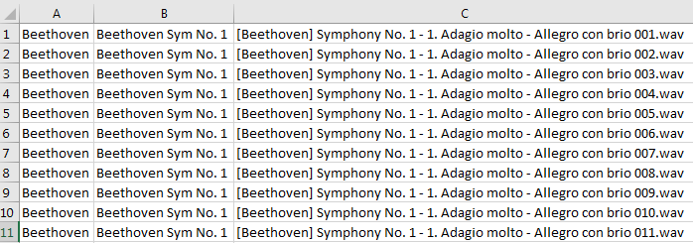
Pre-Processing
Label the excel file columns
Composer (A)
Composition (B)
Segment Name (C)

Slide 30
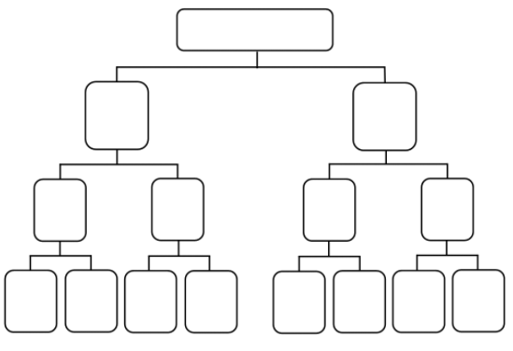
Feature Selection
Initial feature selection results to at most 600 features.
Trim down to 20 features using decision tree learning.
First 20 nodes
(top-down) would
be selected as the
top features.
Notes:
Why Decision Tree learning?
Mirrors human decision making more closely than other approaches.
Performs well with large datasets.

Slide 31
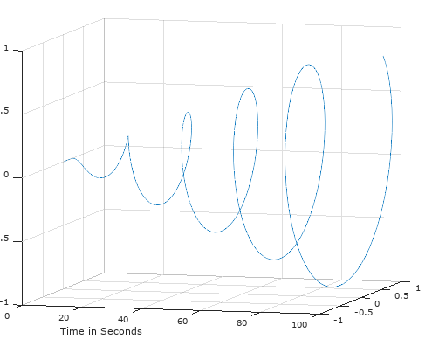
Visualization
OpenGL
Euclidean Distance

Slide 32
Performance Evaluation
50 human participants within 2 months
Knowledgeable in music
To annotate marked regions in the player.
Also given the freedom to annotate unmarked regions.

Slide 33
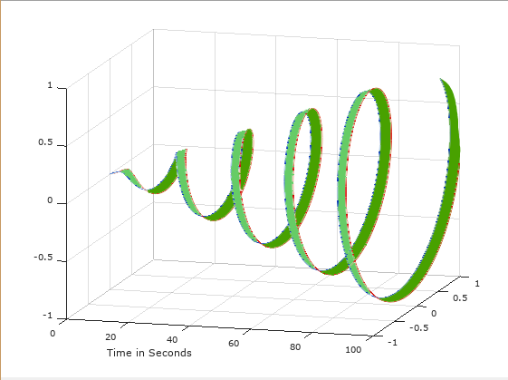
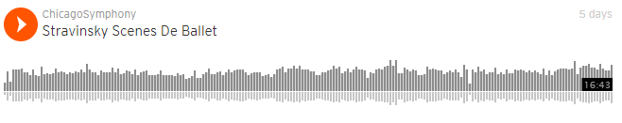

Slide 34
Calendar of Activities for 2017
Activities | JUN | JUL | AUG | SEPT | OCT | NOV | DEC
1 | ♫♫♫ | ♫♫♫ | ♫
2 |  |  | ♫ | ♫♫♫ | ♫♫
3 |  |  |  | ♫♫ | ♫♫ | ♫♫♫♫ | ♫♫
4 |  |  |  |  |  | ♫♫ | ♫♫
5 |  |  |  | ♫♫ | ♫♫ | ♫♫ | ♫
6
7 | ♫♫ | ♫♫♫ | ♫♫ | ♫♫♫ | ♫♫♫♫ | ♫♫♫♫ | ♫♫
1. Concept formulation and RRL Legend: ♫ - 1 week ( 10 hours)
2. Data gathering
3. Pre-processing
4. Feature Selection
5. Visualization Development
6. Performance Evaluation and Human Evaluation
7. Documentation

Slide 35
Calendar of Activities for 2018
Activities | JAN | FEB | MAR | APR | MAY | JUN | JUL
1
2
3
4 | ♫♫♫
5 | ♫♫♫ | ♫♫♫♫
6 |  |  | ♫♫♫♫ | ♫♫♫♫ | ♫♫♫ | ♫♫♫
7 | ♫♫♫ | ♫♫♫♫ | ♫♫♫♫ | ♫♫♫♫ | ♫♫♫♫ | ♫♫♫♫ | ♫♫
1. Concept formulation and RRL Legend: ♫ - 1 week ( 10 hours)
2. Data gathering
3. Pre-processing
4. Feature Selection
5. Visualization Development
6. Performance Evaluation and Human Evaluation
7. Documentation

Slide 36
Summary of Proposal
Using normalized frequency count as a basis for clustering does not consider the notion of time.
To develop 3D visualization method for SOMs

Slide 37
End of Presentation
Thank you for listening!

Slide 38
Self-Organizing Maps (SOM)
Input space is represented into a 2D
Used to encode the musical trajectory of the different symphonies for visual analysis

Slide 39
K-means Clustering
Used to partition similar nodes from the SOM Map
Nodes in close proximity get grouped into a cluster
Clusters represent similarly sounding segments of music
Each music segment will have a Best Matching Unit that assigns where it belongs in a cluster

Slide 40
Time Series
Serial data that includes equally divided points in time order
Visualization
2D to 3D using OpenGL as visualization

